Slide 1
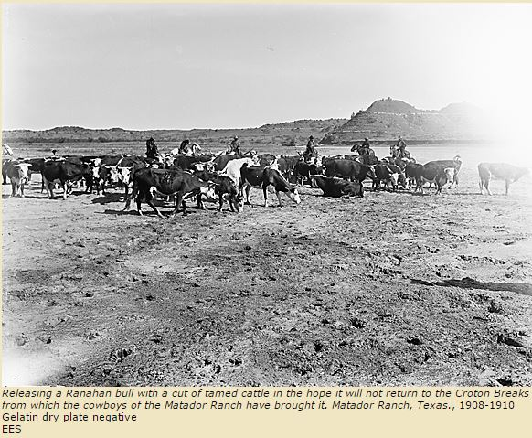
Warm Up March 21, 2016
Why do you think the movement of cattle became necessary?
What are some items that are made from cows?
Erwin E. Smith Collection – Amon Carter Museum

Slide 2
Unit 13 – Cattle Use Chapter 19 (lesson 1& 2) in your textbook to give you ideas of what to draw on your cover. Academic: 5 pictures on your cover Pre-AP: 7 pictures on your cover
Drift Fence
Drovers
Open Ranges
Wrangler
Drive
Mustang
Ranchero
Stockyard
Trail Boss - The cowboy in charge of all other cowboys and cattle on a trail drive.
Rustler – A cattle thief.
Stampede – a sudden, frenzied rush or headlong flight of a herd of frightened animals, especially cattle or horses.
If possible, please bring your phone or tablet on Wednesday. Someone in your group will need to have a QR code reader/scanner app on the phone or tablet.

Slide 3
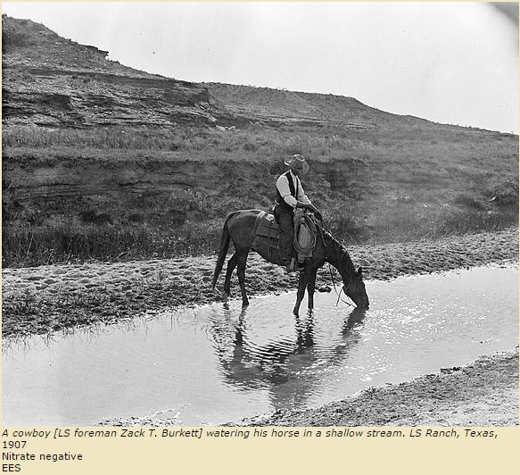
Unit 13 – Cattle Warm Up March 22, 2016
What do you think of when you think of a cowboy?
List several things you think a cowboy did.
Does the picture to the right accurately depict (represent) what you think a cowboy’s life was like? Why or why not?
Erwin E. Smith Collection – Amon Carter Museum

Slide 4
Cowboy Myth vs. Reality
Discovery Education Video
Start seven minutes into the video
If possible, please bring your phone or tablet on Wednesday. Someone in your group will need to have a QR code reader/scanner app on the phone or tablet.

Slide 5
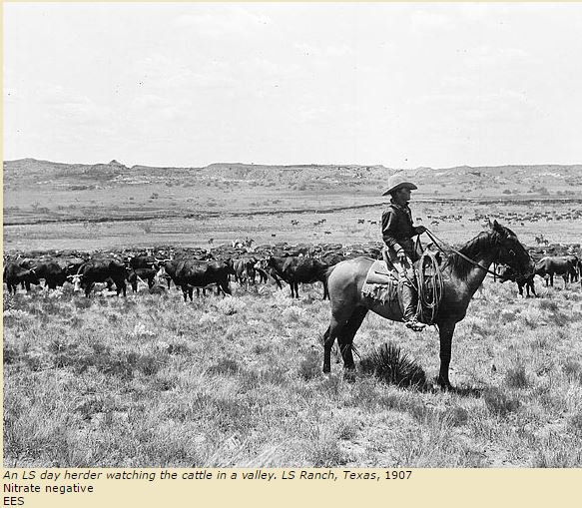
Unit 13 – Cattle Warm Up March 23, 2016
Based on what you know so far about the cowboy life, what type of role or position would you like fulfill while on the trail? Why?
If you are still unsure about the various roles that were available to cowboys on a cattle trail, what positions do you think were needed on a cattle drive? Why do you think the positions you listed are necessary?
Erwin E. Smith Collection – Amon Carter Museum

Slide 6
Unit 13 – Cattle Warm Up March 28, 2016
If you were a trail boss back in the late 1800s, what are some of the qualities you would look for in a cowboy you needed to hire? Looking at the trail map and based on the information you know about Texas geography, what trail would you have liked to take?
Additionally, what are some of the advantages of moving slowly on a cattle trail? What are the disadvantages of moving too slowly on a cattle trail?
Erwin E. Smith Collection – Amon Carter Museum

Slide 7
Cowboy Myths vs. Realities

